Slide 1
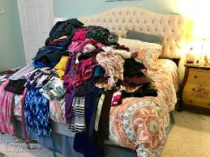
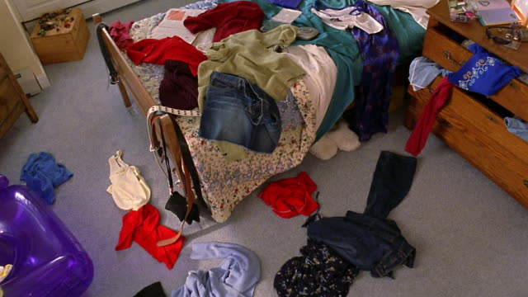
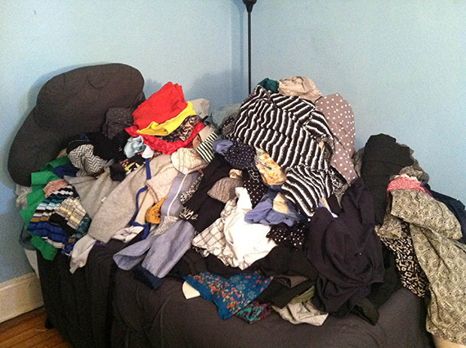
Does This Stress You Out?
02

Slide 2
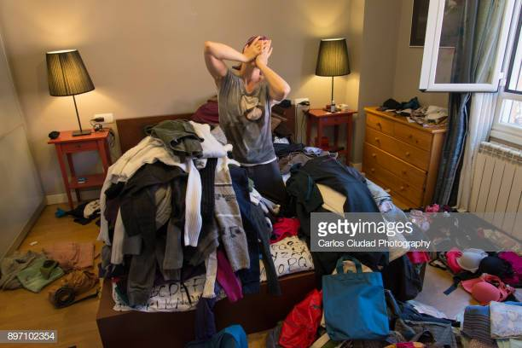
Is This You?

Slide 3
We Can Help
We have created an app that organizes you’re clothing. Whether you’re at home or on the road, you will be able to scroll through your closet with ease. Maybe there’s something in the back of your closet you forgot about? Or something in the bottom of the drawer you never see? No need to worry, we’ll take care of it. Whatever the occasion, you will be able to easily pick out your outfit.
04
y an opinion

Slide 4
Demonstration

Slide 5
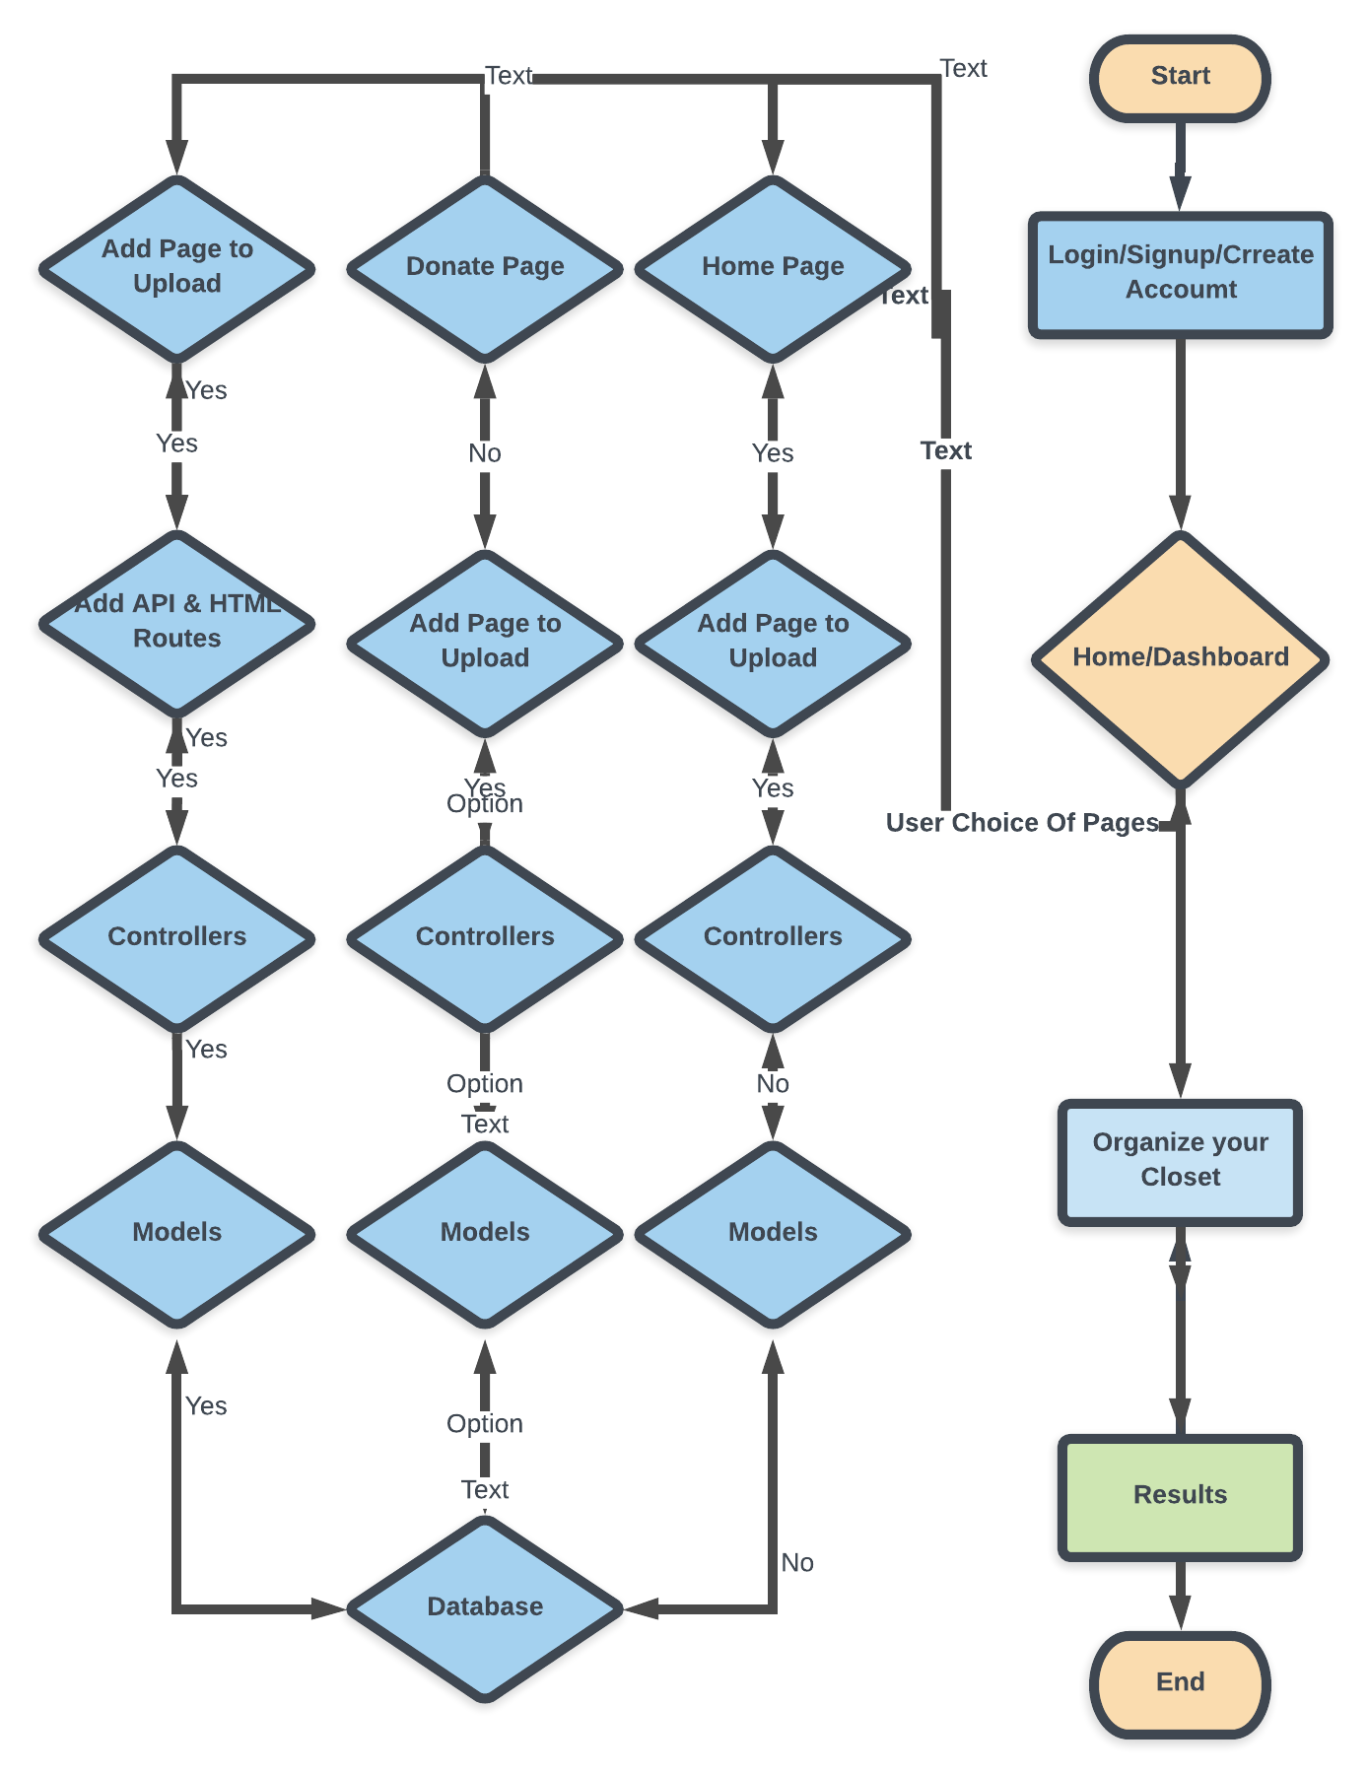

Slide 6




Languages Used to Create Website
32

Slide 7

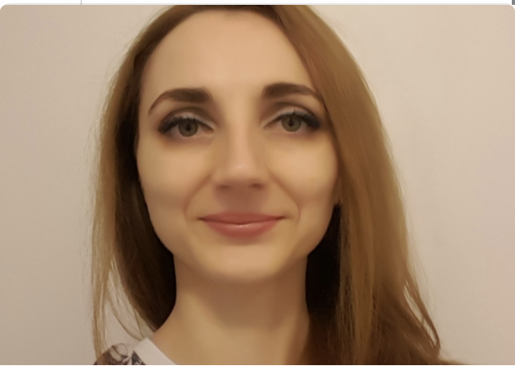


Meet The Developers
Mark Sobchuk
Natalia Malcova
Kisanet Asfaha
David Irizarry
Developer
Developer
Developer
Developer
Javascript
Passport
Node
Express
Sequelize
HTML
CSS
Bootstrap
Design
javascript
Javascript
Jquery
Node
Express
Sequelize
HTML
CSS
Bootstrap
Sequelize
Javascript
07

Slide 8

Portfolio
The End
Questions?
41

